Slide 1
Career ABC Class Book
Notes:
Career day song: http://www.youtube.com/watch?v=CR71AhdHadM
http://www.youtube.com/watch?v=KlklOxhHusY

Slide 2
What is a career?

Slide 3
Why are careers important?

Slide 4
What is the impact of education?

Slide 5
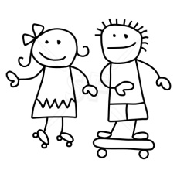
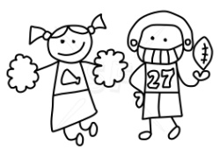
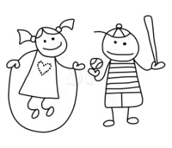
For every 100 ninth graders…
College Board(2006). CollegeEd creating a college going culture guide. New York, NY: Author.

Slide 6
67 will finish high school in 4 years…
College Board(2006). CollegeEd creating a college going culture guide. New York, NY: Author.

Slide 7
18 will earn and associates degree in 3 years of a bachelors degree in 6 years.
College Board(2006). CollegeEd creating a college going culture guide. New York, NY: Author.

Slide 8
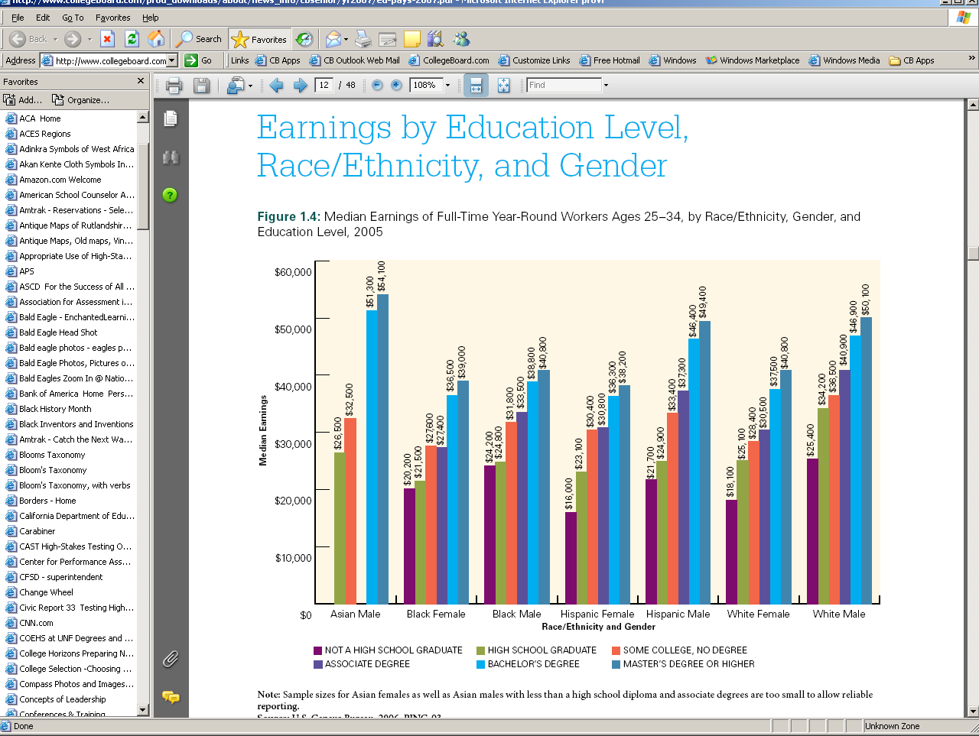
Document source: Trends in Higher Education Series; Education Pays 2007: The Benefits of Higher Education for Individuals and Society. Baum, Sandy & Ma, Jennifer. College Board publication.

Slide 9
Document source: Trends in Higher Education Series; Education Pays 2007: The Benefits of Higher Education for Individuals and Society. Baum, Sandy & Ma, Jennifer. College Board publication.

Slide 10
Document source: Trends in Higher Education Series; Education Pays 2007: The Benefits of Higher Education for Individuals and Society. Baum, Sandy & Ma, Jennifer. College Board publication.

Slide 11
The President’s Goal is to lead the world in the number of college graduates by 2020—moving the college completion rate from 40% to 60% for 25 – 34 year olds.
Economic Security and a 21st Century Education: Secretary Arne Duncan’s Remarks at the U.S. Chamber of Commerce’s Education and Workforce Summit, 2009

Slide 12
What does this mean for school counselors?

Slide 13
Career Development
School counselors are charged with helping students:
acquire the skills to investigate the world of work in relation to knowledge of self and to make informed career decisions.
employ strategies to achieve future career goals with success and satisfaction.
understand the relationship between personal qualities, education, training and the world of work.
American School Counselor Association (2004). ASCA
National Standards for Students. Alexandria, VA: Author.

Slide 14
School counselors are uniquely positioned as the school professionals best able to guide all students toward college readiness, marshaling forces from across the school, district and community.
National Office for School Counselor Advocacy (NOSCA)

Slide 15
What is College and Career Ready?
According to the Southern Regional Education Board
◦ College Ready means a high school graduate has the reading, writing and math knowledge and skills to qualify for and succeed in entry-level, credit bearing, college-degree courses with out the need for remedial classes.
◦ Career Ready means that high school graduates can read, comprehend, interpret and analyze complex technical materials, can use mathematics to solve problems in the workplace, and can pass a state-approved industry certificate or licensure exam in their field.
Source: ©The Next Generation of School Accountability: A Blueprint for Raising High School Achievement and Graduation Rates in SREB States, 2009.

Slide 16
How do school counselors systemically integrate College and Career Ready Initiatives into school counseling programs?

Slide 17
8 Components of College and Career Readiness Counseling
1. College Aspirations
Goal: Build a college-going culture based on early college awareness by nurturing in students the confidence to aspire to college and the resilience to overcome challenges along the way. Maintain high expectations by providing adequate supports, building social capital and conveying the conviction that all students can succeed in college.
2. Academic Planning for College and Career Readiness
Goal: Advance students’ planning, preparation, participation and performance in a rigorous academic program that connects to their college and career aspirations and goals.
(NOSCA, 2010)

Slide 18
8 Components of College and Career Readiness Counseling
3. Enrichment and Extracurricular Engagement
Goal: Ensure equitable exposure to a wide range of extracurricular and enrichment opportunities that build leadership, nurture talents and interests, and increase engagement with school.
4. College and Career Exploration and Selection Processes
Goal: Provide early and ongoing exposure to experiences and information necessary to make informed decisions when selecting a college or career that connects to academic preparation and future aspirations.
(NOSCA, 2010)

Slide 19
8 Components of College and Career Readiness Counseling
5. College and Career Assessments
Goal: Promote preparation, participation and performance in college and career assessments by all students.
6. College Affordability Planning
Goal: Provide students and families with comprehensive information about college costs, options for paying for college, and the financial aid and scholarship processes and eligibility requirements, so they are able to plan for and afford a college education.
(NOSCA, 2010)

Slide 20
8 Components of College and Career Readiness Counseling
7. College and Career Admission Processes
Goal: Ensure that students and families have an early and ongoing understanding of the college and career application and admission processes so they can find the postsecondary options that are the best fit with their aspirations and interests.
8. Transition from High School Graduation to College Enrollment
Goal: Connect students to school and community resources to help the students overcome barriers and ensure the successful transition from high school to college.
(NOSCA, 2010)

Slide 21
What levels (ES, MS, HS) do each of the components occur?

Slide 22
Component | Elementary | Middle | High
College Aspirations
Academic Planning for College and Career Readiness
Enrichment and Extracurricular Engagement
College and Career Exploration and Selection Process
College and Career Assessment
College Affordability Planning
College and Career Admission Processes
Transition from High School to College Enrollment
(NOSCA, 2010)

Slide 23
(NOSCA, 2010)

Slide 24
Career Development in the Elementary School
Careers unfold and develop throughout the life span.
For children and adolescents, school and leisure activities are their work.

Slide 25
Elementary School Students
Elementary children:
Formulate a sense of competence and interests with the world beyond their home.
Learn about life patterns through exposure to adults in the school and community as well as TV and other media.
Make assumptions about their current and future place in the world through exposure to adults.

Slide 26
Elementary School Students
Elementary children:
Benefit from exposure to a broad range of nontraditional models of career choice.
Benefit when career development helps them broaden their natural sense of curiosity.
Often engage intensely in fantasy-based occupational play – Firefighter.
Begin to engage in autonomous future planning behaviors when curiosity is aroused.

Slide 27
Activity
Small Groups of
Each group will brainstorm at least 3 CCR activities to use with their assigned grade levels. For each activity, identify which CCR component(s) is(are) addressed.
Group 1: K & 1
Group 2: 2 & 3
Group 3: 4 & 5
Be prepared to share with the class

Slide 28
Grade Level | Activity | CCR Component Addressed
K & 1 | Chart (Person, job, salary, help others) SC provides an example and students share/chime in. Ask students for their careers | CCR 4
 | What is College Lesson. Assessing knowledge. Explain college etc. | CCR 1
 | Look through magazine to select people doing careers/jobs. SC shares with students. Students select one picture. Students will ask student who is holding the job questions to figure out/guess the job. | CCR 4
2 & 3 | Making a word search (names of colleges/careers) | CCR 4
 | What comes next: Middle School/High School transition game | CCR 3
 | Assessment: Which words describe student interest & associate that with career | CCR 2
4 & 5 | Exploring Non-traditional careers by groups, mini research project using computers. Present to class | CCR 4
 | Questionnaire to assess strengths; group by strengths and have stations to explore strength | CCR 5
 | Activity Fair: Getting to know middle school extra curriculars | CCR 3

Slide 29
Middle or Junior High School Students
Focus on:
Fluctuating sense of self.
Preoccupation with belonging – heavily influenced by same-gender peers.
Helping students crystallize and articulate their identities.

Slide 30
Importance of Career Development in Middle School
Choices for careers most often require college degrees or other substantive training past high school rather than jobs now held by the majority of the workforce.
This necessitates sound educational planning in grades 6-8.
Student learning about themselves and the world of work is translated into an education plan for the remainder of their high school experience.
Career awareness and self-awareness is critical to make informed choices about educational planning.

Slide 31
Middle School
Educational and career planning and interventions in middle school must be directed towards helping students cope with crystallizing and specifying occupational preferences.
Link specific subjects to occupational success, academic achievement, and attainment.
Teach students how to locate, understand, and use career information to foster independent occupational activity.
The primary focus is on exploration and learning about their personality types.

Slide 32
High School
Focus on identifying occupational preferences and clarifying lifelong choices.
The majority of secondary school students enter the workforce immediately after leaving high school or with some high school.
Workforce readiness is necessary to make a successful transition.
Work ready – college ready.
Because adolescents have lived their life primarily at home, in school, and the community, transition to post secondary roles may require assistance to normalize the change as a normal challenge.
Skills include writing a resume, interviewing, writing cover letters, filling out applications, and work place behaviors.

Slide 33
High School
Career development tasks for adolescents emerge from expectations inherent in academic curricula and society.
Career decisions are expected at specific points in the high school curricula.
Essential to orient students to the task they will face and the decisions they will have to make.
Help students plan out the calendar of decisions they must make.
Re-emphasize the need for ALL students to receive all career and educational planning materials.
Equity is the foundation of career development for all students.

Slide 34
Considerations in Planning Career Development Interventions
Become a constant observer of children.
Notice how they approach tasks.
Notice the activities they choose.
Encourage initiative.
Notice the thematic patterns that emerge.

Slide 35
Considerations in Planning Career Development Interventions, continued
Consider the processing of an activity as important as the activity itself.
Focus feedback on the specifics of a child’s efforts to develop a sense of industry rather than inferiority.
Provide opportunities for children to express their beliefs about themselves in relation to various occupations.

Slide 36
Parental Involvement
Parents have substantial influence over the career development of their children.
They provide greatest amount of direct and indirect exposure to work.
Their influence is most effective when it is planned, intentional, and goal-oriented.
They, however, possess minimal knowledge of career development theory and how environmental factors affect development.

Slide 37
Ways in Which Parents Can Assist Children (Herr & Kramer)
Encourage children to analyze self-characteristics (interests, capacities, values)
Communicate work requirements to children.
Discuss the importance of work values in work behavior.
Explain the relationship among work, pay, and the economic condition of the family.

Slide 38
Ways in Which Parents Can Assist Children (Herr & Kramer)
Connect children with informational resources (workers, books, films).
Be careful to avoid stereotyping occupational alternatives and workers.
Provide children with opportunities for work in the home and community.
Provide children with opportunities to learn and practice decision-making skills.

Slide 39
Multicultural Implications
Cultural background is an important aspect of career development.
“Life-role readiness” – possession of the knowledge, attitudes, and skills necessary for effective life-role participation in a pluralistic society.
Students need to value and appreciate difference in life-role behavior.
Contextual factors contribute to patterns of life-role salience among secondary school students.
“Inherited” patterns of life-role salience passed on from the dominate culture can be problematic when embedded with beliefs based on stereotypes.
Raising student awareness of life-role salience helps students to be less likely to allow beliefs reflection racist and sexist attitudes to influence their beliefs about their life-role salience.

Slide 40
Classroom Guidance
For your assignment you will
Observe a classroom guidance from Mrs. Foster, submit 1 page reflection on blackboard due 10/ 29
Prepare/deliver classroom guidance at Longfellow E.S. due 11/26
Prior to your classroom guidance you must submit your lesson and pre/post test on blackboard for instructor approval.
Following your classroom guidance you will submit a paper which includes the following:
Summary of Pre/Post Test results
Strengths and areas of growth
Signed teacher evaluation (on template available blackboard)

Slide 41
Learning Considerations When Planning Units & Lessons
Gardner’s theory of multiple intelligences exemplifies the need to teach and assess using various modes:
Verbal/linguistic
Logical/mathematical
Spatial
Bodily Kinesthetic
Musical
Interpersonal
Intrapersonal
Naturalist

Slide 42
Lesson Plans
You are encouraged to develop your own lesson or adapt an existing lesson to use. Your plan should answer the following:
What will be delivered
To whom it will be delivered
How it will be delivered
How it will be evaluated
Format
ASCA Student Standards (On Blackboard)
Learning Objectives
Materials
Procedure
Plan for Evaluation
Follow-up

Slide 43
Evidenced-Based Practice
Developing Pre- and Posttests
If you need to develop your own pre- and posttests, this process is really straightforward. The general process for creating pre- and posttests is as follows:
Determine key ideas and concepts using learning goals (knowledge, attitudes, and skills) linked to state curriculum standards and the ASCA National Standards whenever possible.
Brainstorm 10 to 15 possible questions that would effectively assess students’ knowledge, attitudes, and skills prior to the lesson and after the concepts have been presented. If the students are able to answer all of the questions without having the lesson, the lesson was not necessary.
References: American School Counselor Association. (2003); Dimmitt, C, Carey, J. & Hatch, T. (2007).

Slide 44
Evidenced-Based Practice
Developing Pre- and Posttests
If you need to develop your own pre- and posttests, this process is really straightforward. The general process for creating pre- and posttests is as follows:
Select 5 to 10 questions (out of your original brainstormed list) using multiple choice, true/false, and fill-in-the-blank answer formats.
Type the 5 to 10 questions on an 8.5” X 11” page, taking note of the spacing and the organization of the page. The top of the page should include space for a student’s name and the date, and a space to designate whether it is a pre- or posttest.
References: American School Counselor Association. (2003); Dimmitt, C, Carey, J. & Hatch, T. (2007).

Slide 45
Evidenced-Based Practice
Developing Pre- and Posttests
If you need to develop your own pre- and posttests, this process is really straightforward. The general process for creating pre- and posttests is as follows:
Photocopy the pre- and posttests - one for every student - on separate sheets of paper. Scantron sheets or an online survey format system such as Survey Monkey (www.surveymonkey.com”) or Zoomerang (www.zoomerang.com) can facilitate this process.
Administer to pretest before the lesson is taught. Use this data to influence your instruction. Administer the posttest after the lesson
Grade to pre- and posttest and calculate the percentage increase in knowledge.
References: American School Counselor Association. (2003); Dimmitt, C, Carey, J. & Hatch, T. (2007).

Slide 46
Using EZ Analyze
View the sample to see how you can organize your data. Each student should have a pre and post test results
Make sure that you get the raw score (sum) for each.
Create another table with two columns: Pre-Test Score & Post Test Score. You will use your data in this form for analysis.
Once your data is organized, open use EZ Analyze to perform a Paired T-Test
Select: EZ Analyze>> Advanced>> T-Tests>> Paired Sample
In “Paired Tests” Variable 1: “Pre Test Scores”; Variable 2: “Post Test Scores; Select OK.
When the analysis is run, look for the P-Value. P-Values less than 0.05 indicate a statistical significance.

Slide 47
On the Horizon
Supervision group 1 this week
Supervision group 2 next week
Next week, Ethics Exam
Observations of classroom guidance
Classroom Guidance Presentations
Provide Lesson Plan & Pre/Post Test for Instructor Approval
Continue to meet individually with students

