Slide 1
Mentor Training
Samantha Lamb, Natalie Sachs, & Sadie Wright
Counseling Interns
Notes:
Natalie- Introductions, dodrill will speak, we are going to go over the steps to be a good mentor, we know that you already do these steps with your students. We thank you for attending this formal training.

Slide 2
“A lot of people have gone further than they thought they could because someone else thought they could.”
-Unknown
Notes:
sam

Slide 3
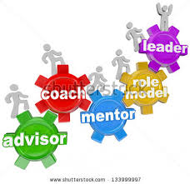
Why is Mentoring Important?
The process transforms both parties (reciprocal relationship)
Emotional support
Psychosocial support
Give advice on academic performance and career paths
Help guide the student; lead them on a path to success!
Opportunity to share your skills and experiences
You can make a difference!
Notes:
Sadie - you might be the only source of support the student feels like they have, so really, you may make a huge difference in their lives
sharing skills - a different way for you to share your skills; gives a new perspective

Slide 4
Potential Benefits of this Program
For Teachers
Making a difference
New perspective
Grow & develop
For Students
Someone to look up to
Emotional and Academic Support
Ally within the school
Notes:
Sadie

Slide 5
Questions to Ask Yourself...
Why do you want to be a mentor?
What do you see as your role: to listen, to lead, or both?
How much time do you have to spend with your mentee?
What topics are you uncomfortable discussing?
How can you increase your level of comfort with your mentee?
Is confidentiality an issue for you?
What do you hope to accomplish?
Notes:
why do you want to be a mentor? As Sadie just stated, it is beneficial for you as well, so why are you choosing to mentor? What do you want to get out of it? suggest they do this before the first meeting & throughout b/c it is important to reflect on the relationship & how it is affecting you! (sam) - dont read the questions, just talk about why asking them is important

Slide 6
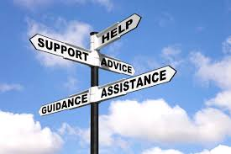
Common Mentor Characteristics
Knowledgeable
Good at problem solving
Approachable
Willing to invest time and energy
Respectful
Role models of leadership behavior
Supportive
High but achievable expectations
Encourage independent decision making
Notes:
Natalie
As we said earlier, you already possess many of the skills needed to be a mentor, but we will go over them in the mentor context
knowledgable: be able to help students think through problems and help brainstorm solutions they haven’t thought of
Approachable: with the mentor/mentee relationship students will not always feel confident enough to approach you, however the more approachable you seem the more they will feel they can talk to you

Slide 7
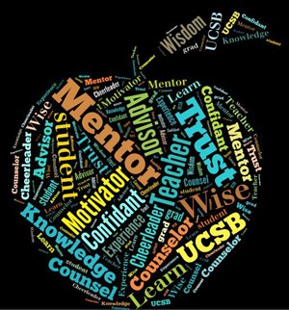
Teacher as Mentor
Similar Characteristics
One-on-one
guiding vs. grading
Facilitate growth of the student
Apply skills needed as a teacher
to the mentor/mentee context
Notes:
Natalie
As a teacher you already possess all of these skills, mentoring may just have a different spin on some of the same skills

Slide 8
Stages of Mentoring
Stage 1: Building the Relationship
Stage 2: Exchanging Information and Setting Goals
Stage 3: Work towards Goals and Build Engagement
Stage 4: Ending the Relationship and Planning for the Future
Notes:
sam

Slide 9
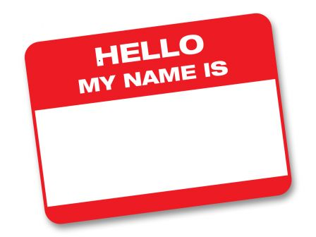
Stage 1: Building The Relationship
Get to know each other & establish trust
Discuss confidentiality and reach an agreement
Agree on a meeting time
Discuss potential SMART goals
Talk about previous experiences
Notes:
sam

Slide 10
Understanding Differences
Remember your student most likely has different values than you do
What are the major differences?
How would you handle a conflict about these differences?
What are the positive & negative consequences of influencing your mentees values?
Communication is the key
Active Listening
Open Ended Questions
Openness to learn
Non-judgmental Attitude
Notes:
Sadie

Slide 11
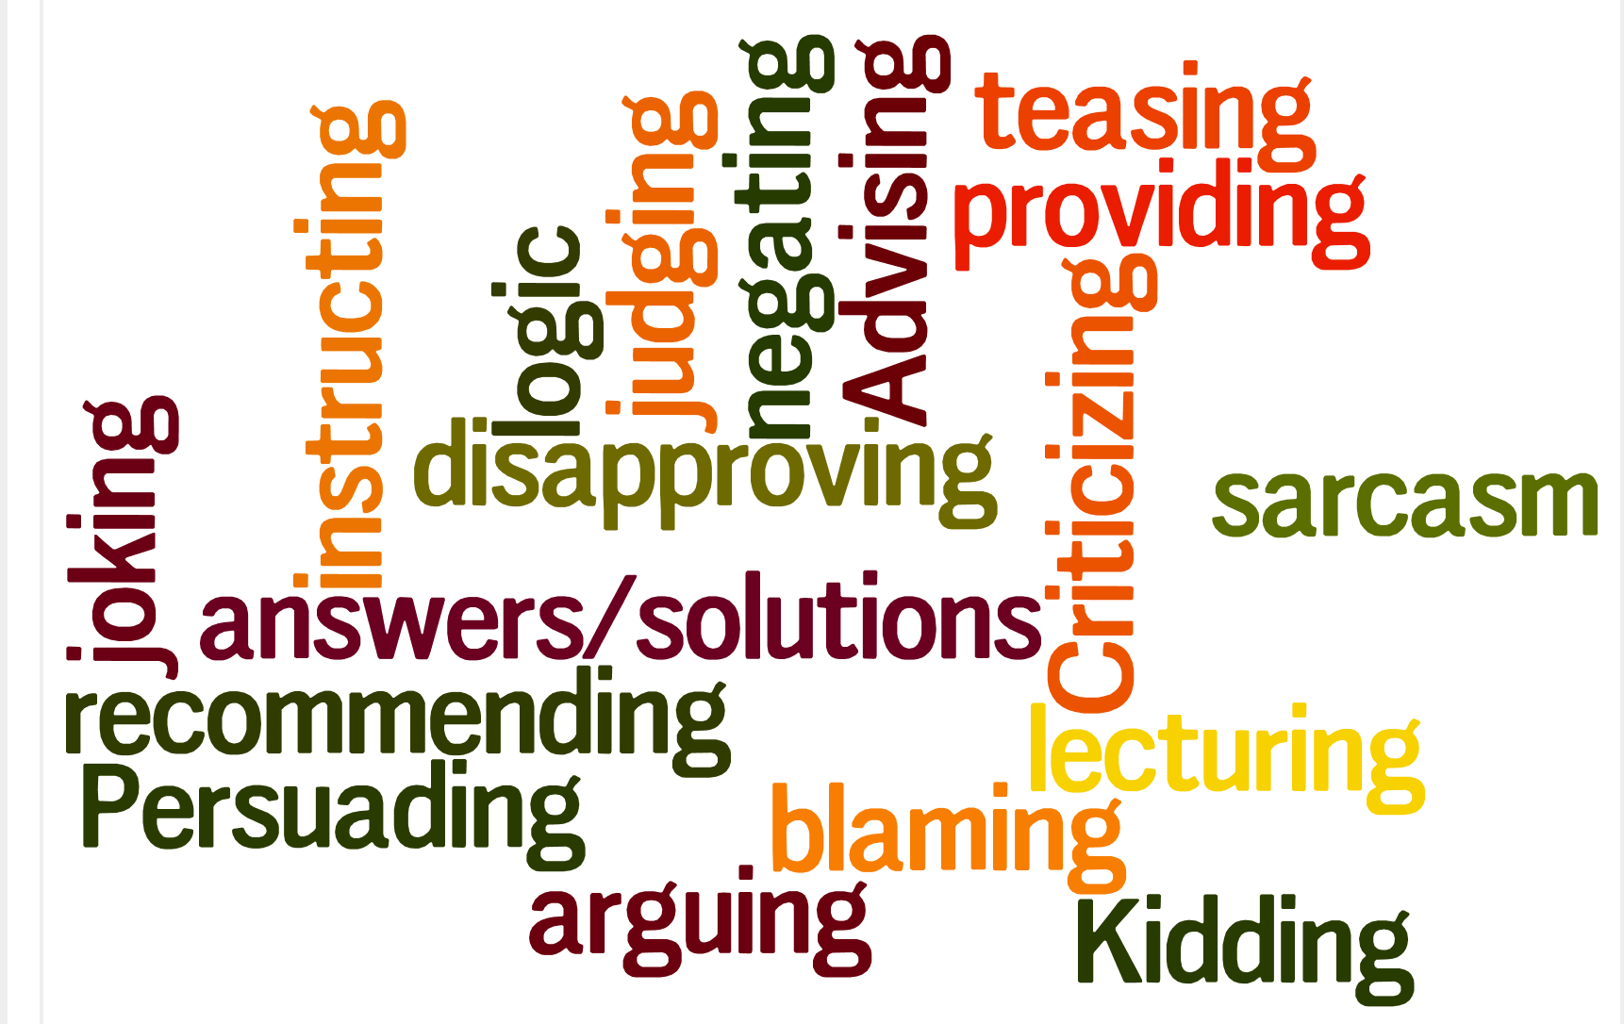
possible Roadblocks
Notes:
Sam context is key, most of these such as kidding could be a positive, it depends on the relationship that you have built with your student and understanding where they are coming from --- page 20

Slide 12
Responsibilities
Scheduling a definite time to meet each week
Attending the scheduled meeting
Contacting each other on a regular basis
Following through on goals and responsibilities
Be respectful and considerate
Notes:
Natalie

Slide 13
Suggestions for Mentors
Weekly check in
Journaling
Collaborate with other mentors
Find out what is working and what could be improved
Find out what the student likes and use that as motivation
Let them tell you what they need!
It’s okay to not always be an expert
Notes:
Sadie
you cant always fix things but you can be there to support them

Slide 14
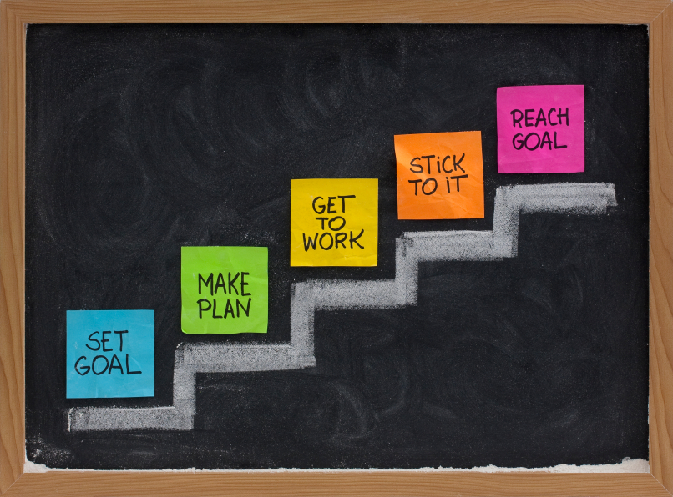
Stage 2: Exchanging information & setting goals
Exchange more information
Practice active listening
Agree upon set goal(s)
write them down
discuss them
Positive reinforcement
time, efforts, insights, etc.
Notes:
Natalie
Practice actvie listening: it is not enough to be there you also need to be engaged in the relationship and conversation

Slide 15
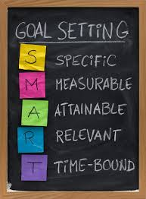
SMART Goals
Specific
Measureable
Achievable
Realistic
Time specific
Notes:
Natalie
Specific: target the behavior or outcome you are seeking
Measurable: able to see if you are making progress (breaking it down into checkpoints)
Achievable
Realistic
Time specific: provide structure and time limits to guide your progress

Slide 16
Suggested questions
How do you feel about this?
What would happen if you did…?
How would you like this to work out?
How will the results of this decision affect you and others?
Is that the effect that you want?
Would it help to get more information?
Have you ever been in a similar situation? What did you do?
How did it turn out?
Notes:
Sadie - these are some potential questions you can ask

Slide 17
Stage 3: working towards goals & Deepening Engagement
Typically the longest stage
Work on achieving goals through conversation, written materials, learning & development activities, outside resources, etc.
Openness & trust, meaningful discussion,
application of new insights/approaches,
and ongoing support
Notes:
Sadie

Slide 18
common issues during Stage 3
Time & Energy
Solution: Think small
Building Trust Quickly
Solution: listen carefully & remember what is said, keep your commitments, avoid negative talk about others, & uphold confidentiality
Notes:
Sam page 16 & 17

Slide 19
Stage 3 issues continued
Expectation that Mentor = Expert
Solution: be open and honest that you don’t have all the answers, express excitement for working together, and express willingness to find answers from other experts
Being Sensitive to Differences
Solution: observe both similarities & differences, and talk about them
Notes:
Sam

Slide 20
stage 4: Ending the formal mentoring relationship & planning for the future
Work with mentee to determine what types of support may be needed in the future
Reflect on accomplishments, challenges, and progress towards goals
What will you remember most about the relationship?
Discuss whether relationship will continue informally
Notes:
Natalie

Slide 21
In review… Things to Avoid
Forcing the student in one direction
Taking over the relationship
Condemning mistakes
Taking credit for mentee’s accomplishments
Losing sight of the “big picture”
Breaching confidentiality

Slide 22
In review… Things you should do
Listen and provide wise counsel
Support and facilitate discussion
Teach by example
Be aware of role conflict
Encourage and motivate
Promote independence and balance
Set SMART goals
Rejoice in successes!
Notes:
Natalie - and Thank you & Needs Assessment! :)
Individual
Group- target more students
SADIE

